Slide 1
Effectiveness Of Phase Dispersion Minimization In Gyrochronology
By: Jeremy Stone

Slide 2
Introduction
Simulated Data
Barry Lutz Telescope (BLT) Data
Catalina Sky Survey Data

Slide 3
Example Light Curve
Period = 7 days
Amplitude = .05
Random error = 2%
Magnitude
Period (Minutes)

Slide 4
Light Curve
Magnitude
Period (Days)

Slide 5
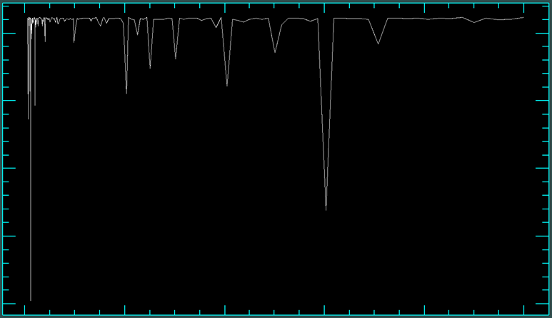
Period
1
Theta
.9
.8
0 2 4 6 8 10
Period (days)

Slide 6
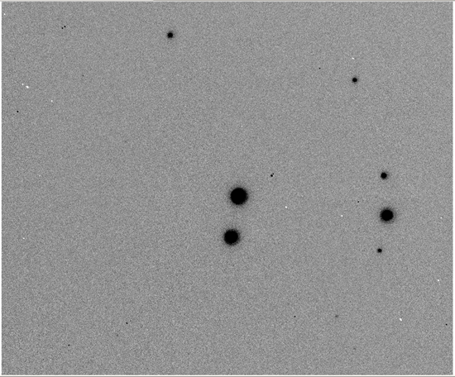
HIP 19859
Target Star

Slide 7
HIP 19859 Light Curve
Relative Magnitude
Date (HJD)

Slide 8
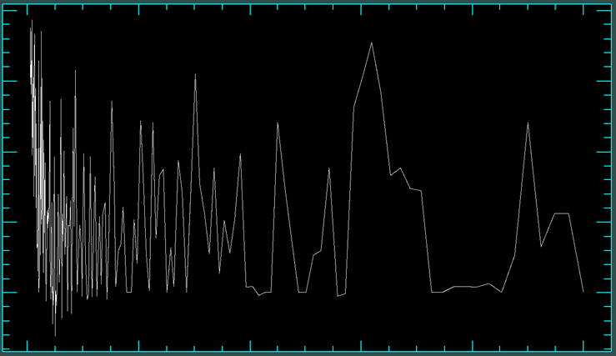
HIP 19859 Period
1
.8
.6
Theta
.4
.2
0 2 4 6 8 10
Period (Days)

Slide 9
Problems and Difficulties
Weather
Technical Issues
Errors

Slide 10
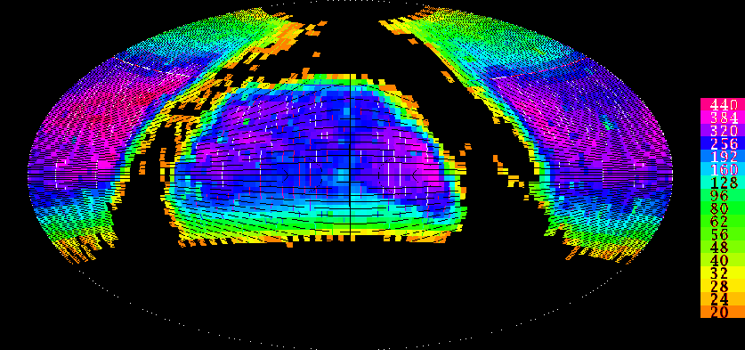
Catalina Sky Survey

Slide 11
Catalina Sky Survey
Started in 2005
Searching for near Earth objects
Photometry on 198 million objects

Slide 12
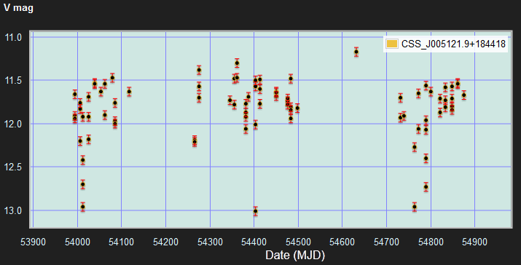
HIP 3998 Light Curve

Slide 13
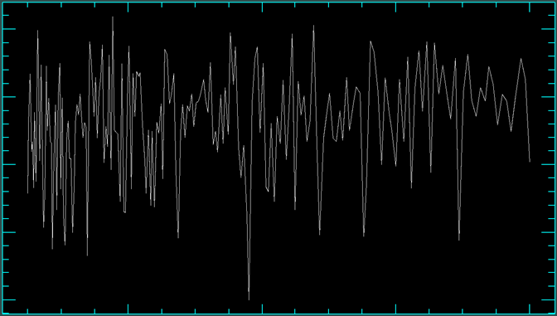
PDM
1.5
Theta
1
.95
.9
.85
.4 .6 .8 1
Period (Days)

Slide 14
Comparing Ages
Collected ages from published papers
Gyrochonology equation
P(B-V,t) = f(B-V) * g(t)
Where f(B-V) = (0.7725 ± 0.011) (B-V₀-0.4)^{0.601±0.024}
And g(t)=t^{0.5189±0.0070}

Slide 15
Thanks
NASA Space Grant
Northern Arizona University
Dr. Koerner
Dr. Barlow and Kathleen Stigmon

